Slide 1

OOPs in JavaScript
By Hariom Patel

Slide 2




What is OOPs?
OOPs = Object-Oriented Programming
Based on real-world concepts
A way to organize code using objects and classes
Makes code reusable, secure, and easy to manage

Slide 3
Why Use OOPs in JavaScript?
Modular and Clean Code
Real-World Modeling
Helps to build modular and clean code
Supports real-world modeling
Easy to Manage
JavaScript Support
Easy to debug, test, and scale
JavaScript supports OOPs using class, object, extends, etc.

Slide 4



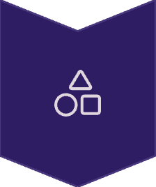
Pillars of OOPs
Encapsulation
Hides internal details
Abstraction
Shows only required info
Inheritance
Child class uses parent features
Polymorphism
Same method, different behavior

Slide 5
Encapsulation & Abstraction
Encapsulation Example
Abstraction Example
class User { constructor(name) { let _name = name; this.getName = () => _name; // Encapsulation }}
class Car { drive() { this.startEngine(); // Abstraction console.log("Car is moving"); } startEngine() { console.log("Engine started"); }}

Slide 6
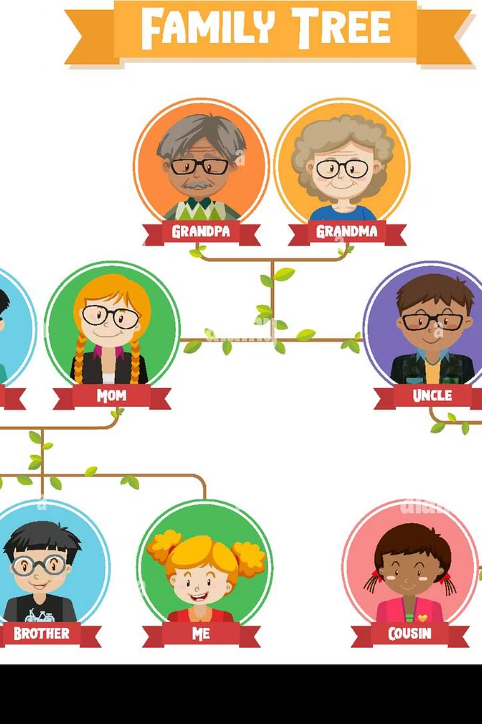
Inheritance
class Animal { sound() { console.log("Animal makes sound"); }}class Dog extends Animal { bark() { console.log("Dog barks"); }}const d = new Dog();d.sound(); // from parentd.bark(); // own method

Slide 7
Types of Inheritance in JS
✅ Single
1
one parent → one child
✅ Multilevel
2
chain of inheritance
✅ Hierarchical
3
one parent → multiple children
❌ Multiple
4
not supported directly
✅ Hybrid
5
mix of types using mixins

Slide 8
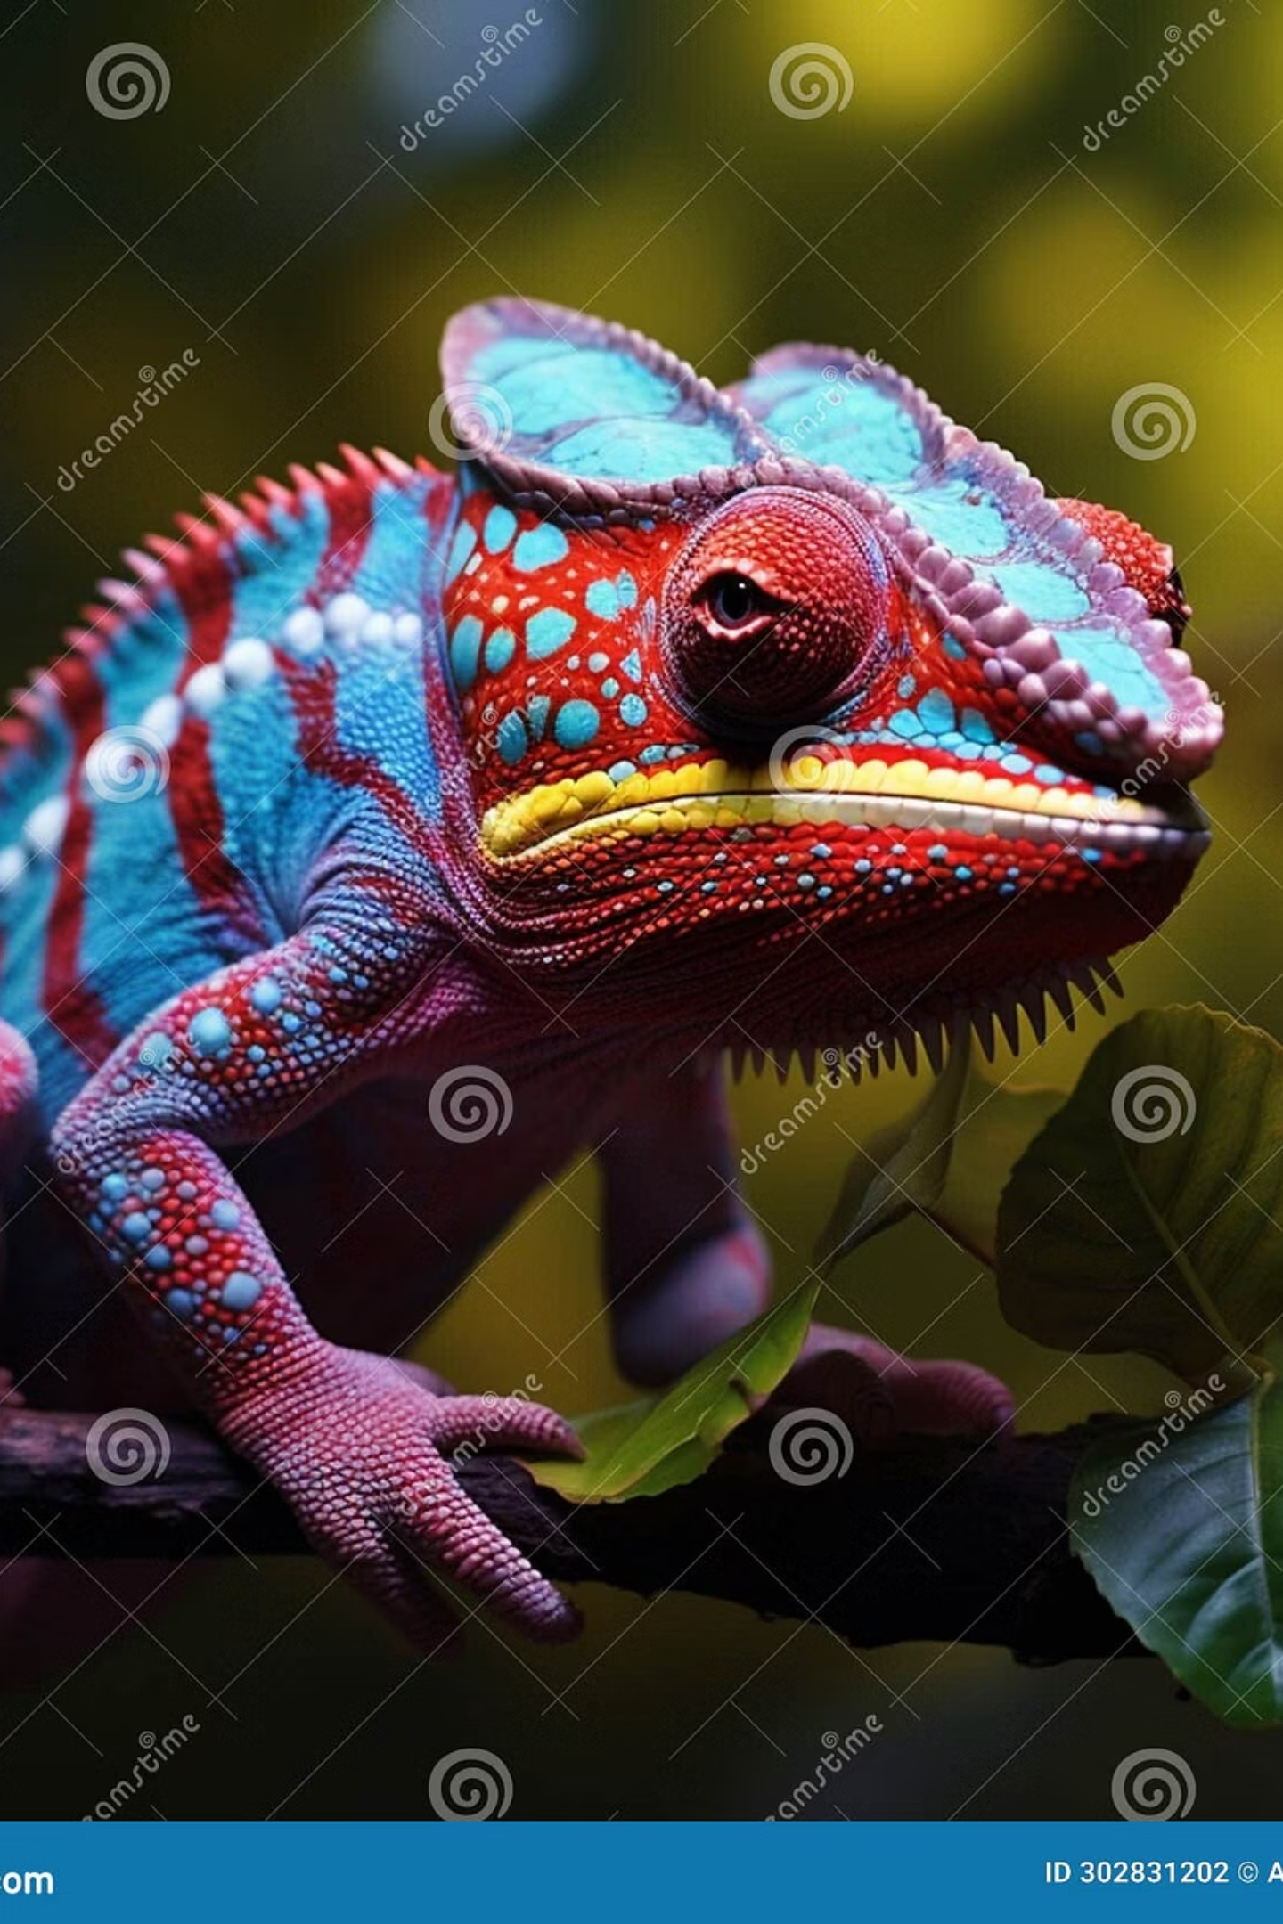
Polymorphism
class Shape { draw() { console.log("Drawing shape"); }}class Circle extends Shape { draw() { console.log("Drawing circle"); }}const c = new Circle();c.draw(); // Method overridden

Slide 9

Class & Object in JS
class Student { constructor(name) { this.name = name; } show() { console.log("Name:", this.name); }}const s1 = new Student("Hariom");s1.show(); // Output: Name: Hariom

Slide 10
Summary
JavaScript supports OOPs fully using class and object
4 pillars: Encapsulation, Abstraction, Inheritance, Polymorphism
Helps in real-world modeling and code reusability
Practice small examples to learn it better
💡 Use OOPs for building clean and scalable apps

